Slide 1














CAPSTONE PROJECT - II
Presented by : ARSALAN AFTAB
DATA ANALYTICS COHORT - III
IPL ANALYSIS 2008-2019

Slide 2



DATA WILL BE HELPING IN THE PROJECT TO
ADDRESS THE MANAGEMENT FOR TAKING DECISION ON RETENTION OF BATSMEN AND BOWLERS.
FINDING BEST FINISHER COMPARISIONS FOR DEATH OVERS WHILE CHASING (2ND INNINGS).
EVALUATE MOST VALUABLE PLAYER SEASON WISE (BATSMEN & BOWLERS)
FIND THE PROPORTION OF WIN BY BATTING FIRST AND INCREASING RUNRATE IN DEATH OVERS.
PREDICTICT RESULT OF THE MATCH ON THE BASIS OF FIRST INNINGS SCORE OF THE MATCH.

Slide 3
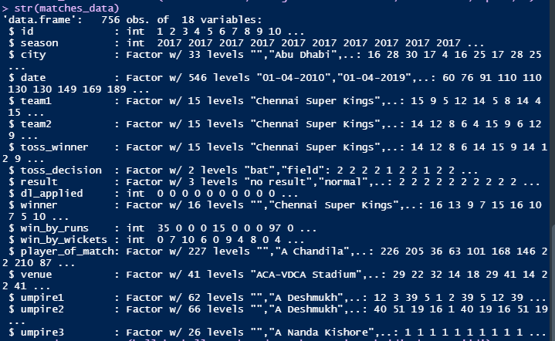
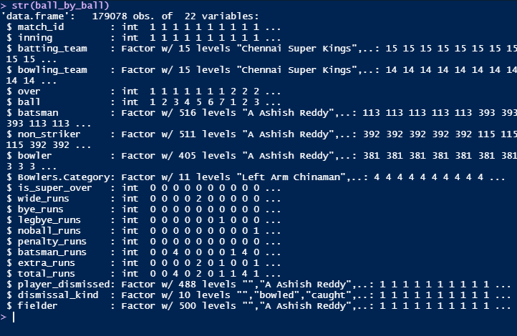
IPL DATA SET 2008-2019
The data set has been obtained from Kaggle, with the following link : https://www.kaggle.com/datasets/nowke9/ipldata it includes following files: matches.csv(Match by Match Data) & deliveries.csv(Ball by Ball Data) & the structure of both the data set are mentioned below:

Slide 4
ADDRESSING THE MANAGEMENT FOR TAKING DECISION ON RETENTION OF BATSMEN AND BOWLERS.
Players are usually selected or retained on the basis of budget assigned to the team, players categories (like platinum, diamond, silver) and players past performances, players rating in ICC usually works on moving average which changes with time, so while considering any player we can not consider all the season he had played in IPL, instead we will check most recent performances like last 3 years or four or five years.
→ Batsmen for opening & middle order are preferred with average 30 and above along with strike rate varying between 125 to 150 to give team a good start and balance the score board with the good number of wickets in hand for middle overs and death overs.
→ Batsmen for lower order are preferred with strike rate above 150+ to give a team a good finish and maintaining the par score with respect to the middle overs game.
→ Bowlers with lesser bowling strike rate ,economy rate and average can be used in every part of the game, but the combination of bowlers can be determined by looking at the distribution of wickets taken by each category of bowlers, conditions also play the pivotal role in selecting bowlers for the individual games.

Slide 5
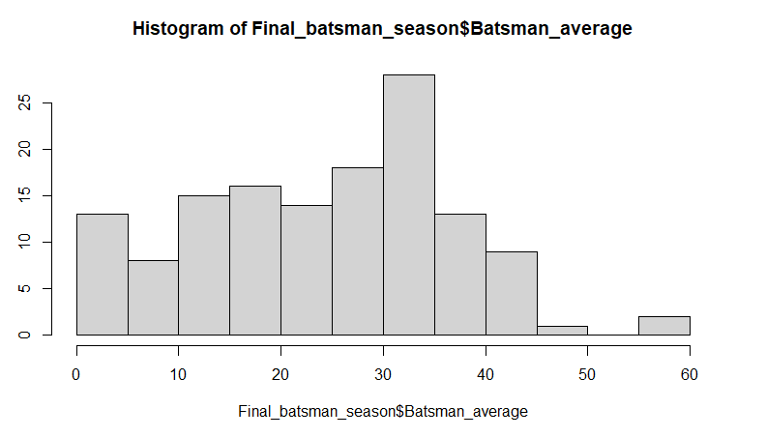
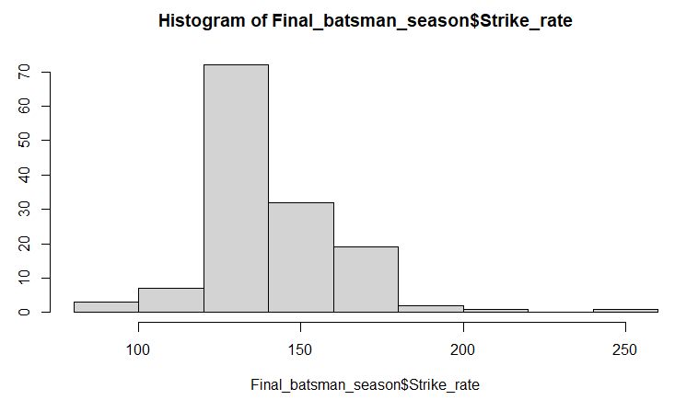
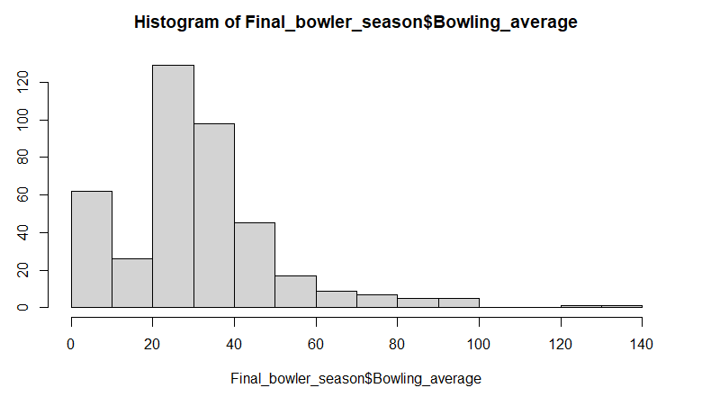
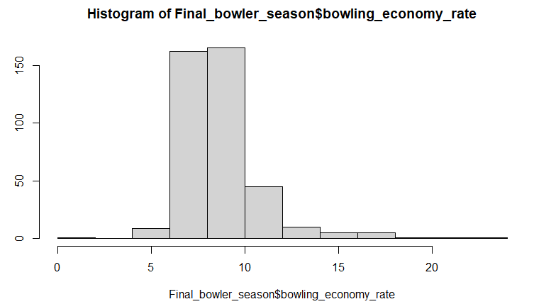
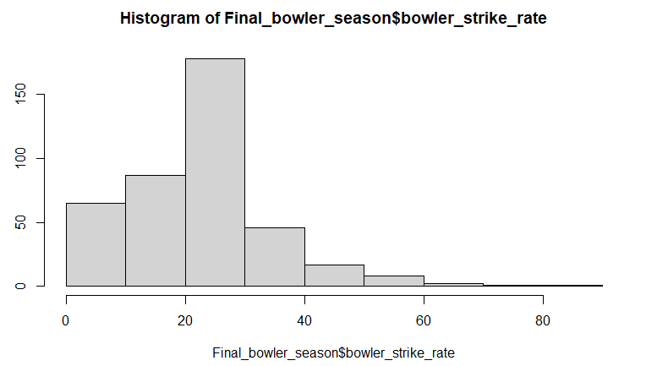

Slide 6
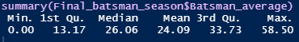
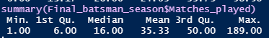

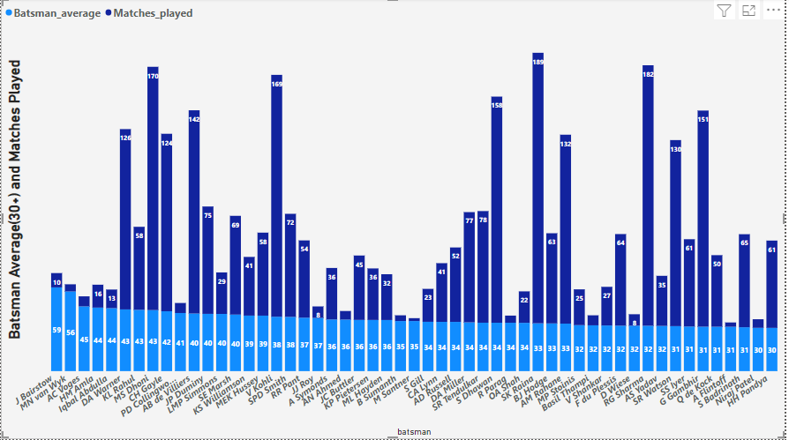

Slide 7
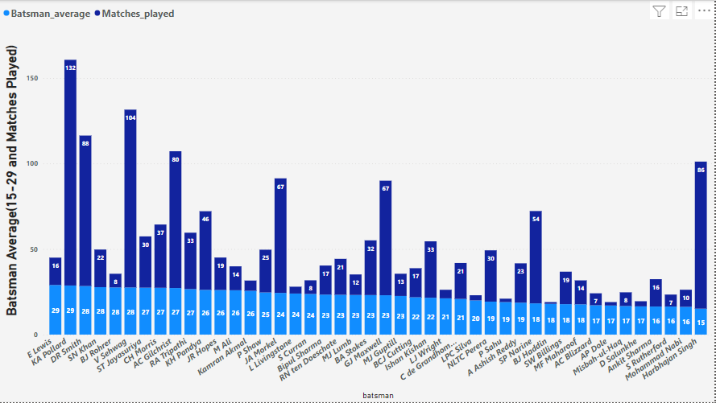

Slide 8
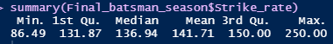

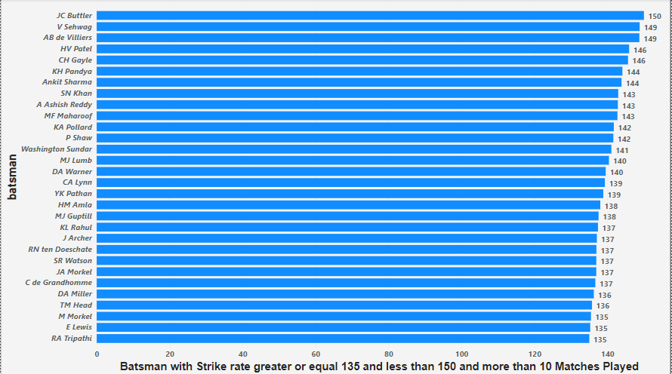

Slide 9
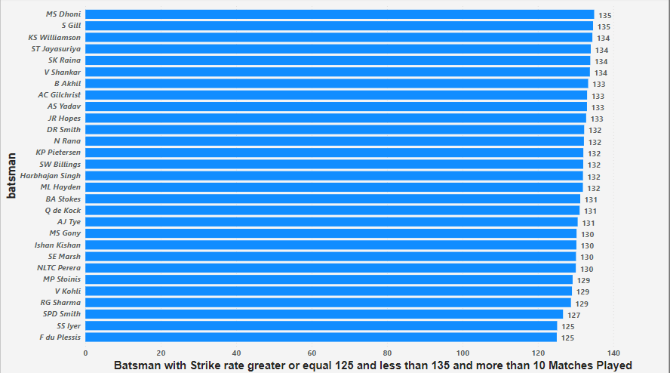

Slide 10
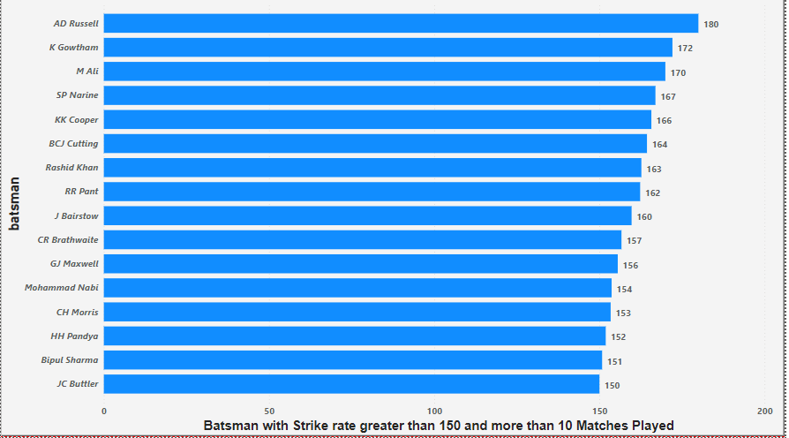

Slide 11
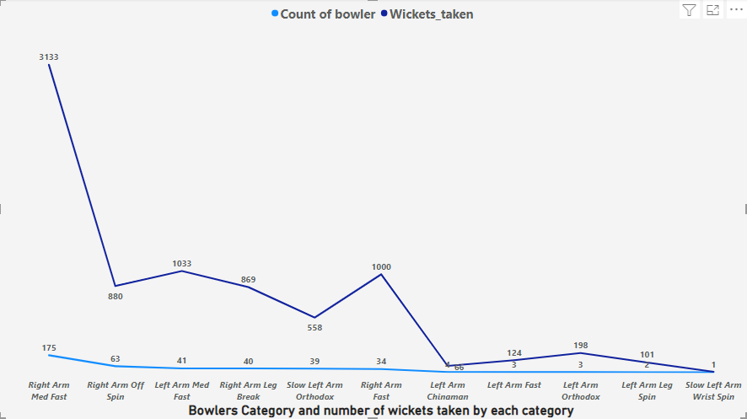
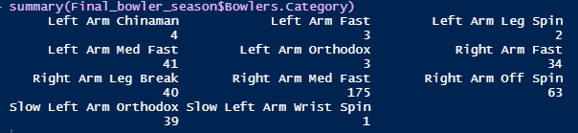
CATEGORY OF BOWLERS AND OVERALL WICKETS TAKEN IN IPL

Slide 12
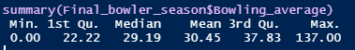

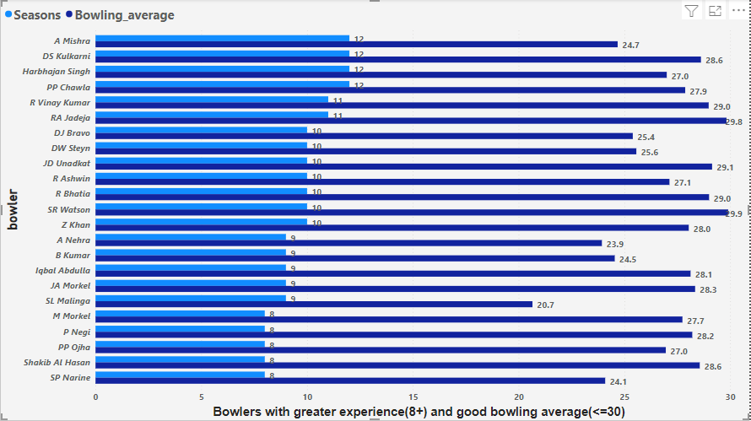

Slide 13
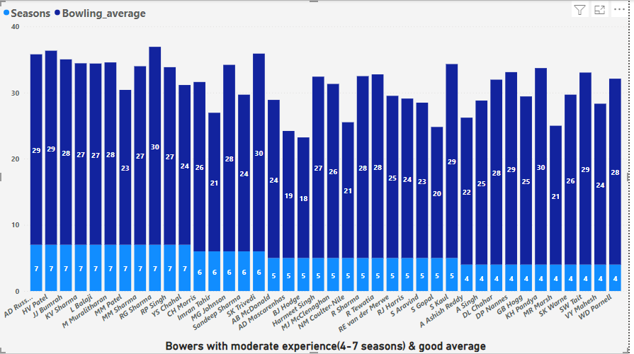

Slide 14
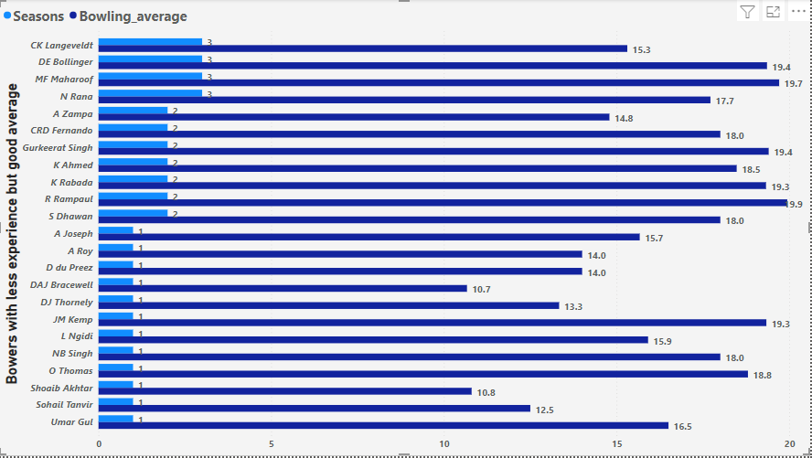

Slide 15
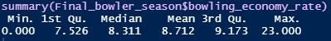
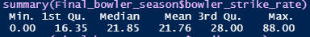


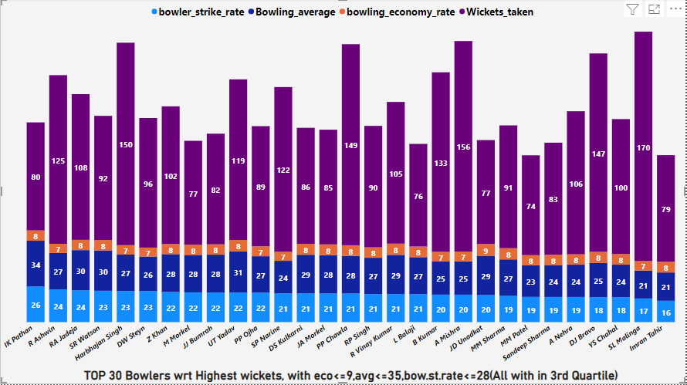

Slide 16
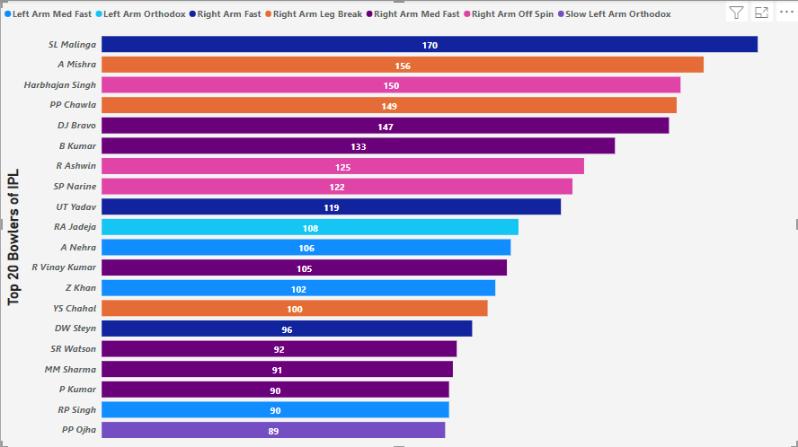
TOP 20 LEADING WICKETS TAKERS IN IPL

Slide 17
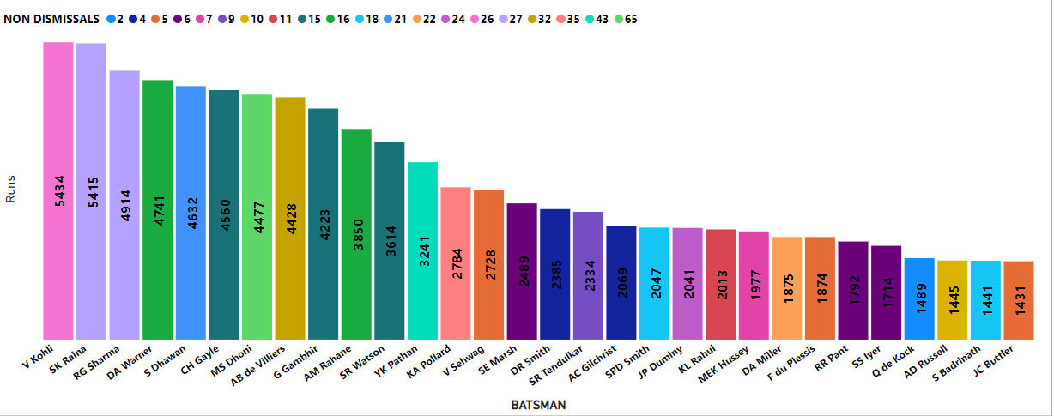
TOP TWENTY RUNS SCORER IN IPL

Slide 18
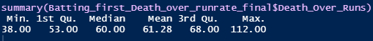
FINDING BEST FINISHER COMPARISIONS FOR DEATH OVERS WHILE CHASING (2ND INNINGS).
Death overs serve as a dresser of the whole game, it can turn the tables on the either side at any glance.
→ In modern day cricket the first batting team try to score with 10+ run rate in death overs in T20.
→ Whereas, bowlers try to restrict the opponents under the run rate of 6 or 8.

Slide 19
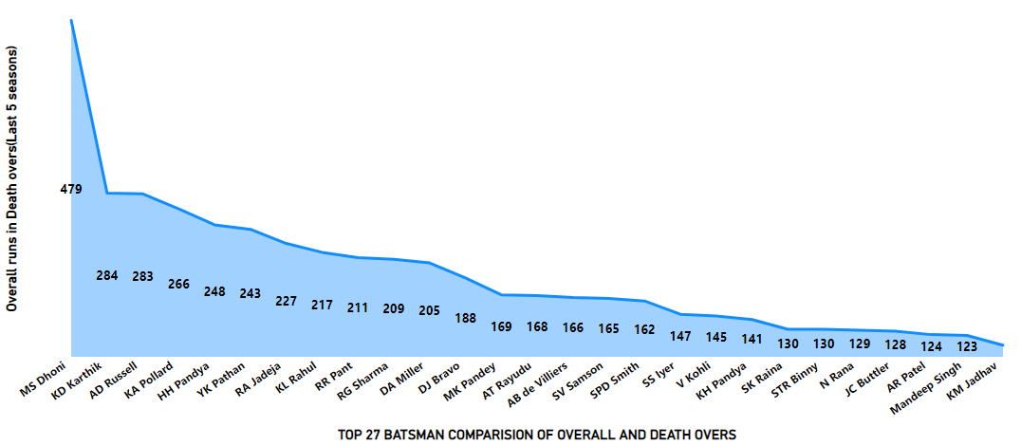

Slide 20
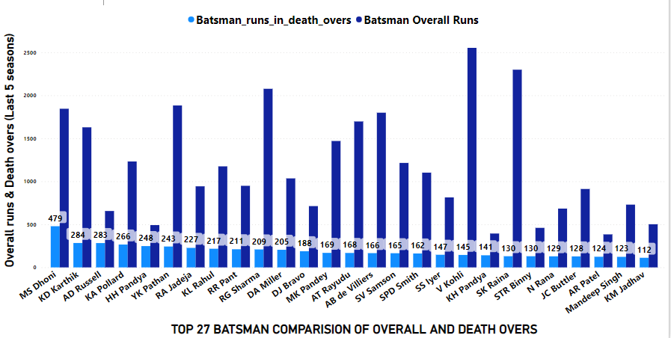

Slide 21
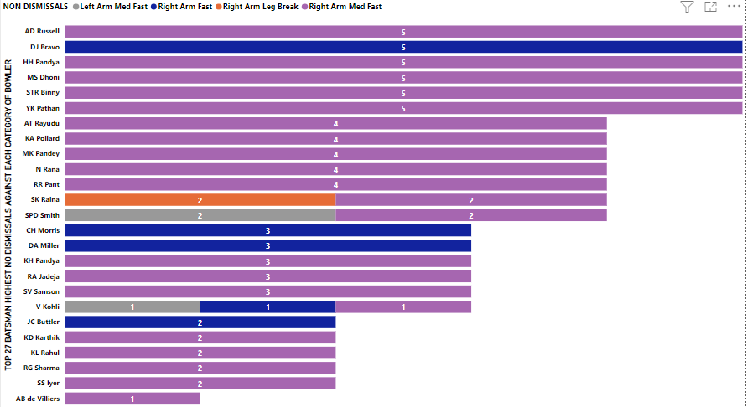

Slide 22
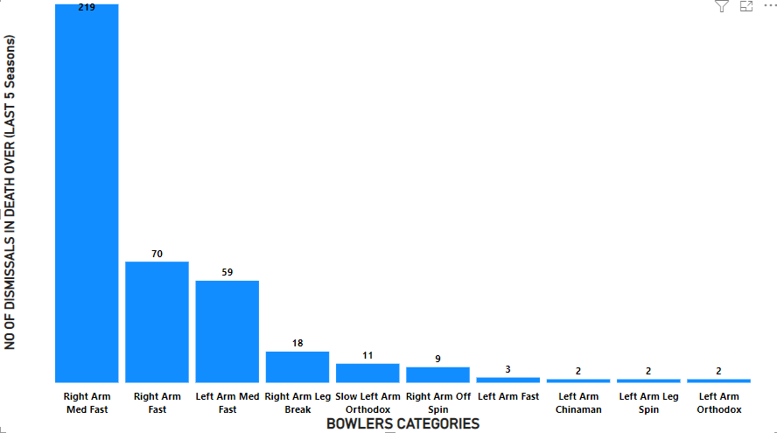

Slide 23
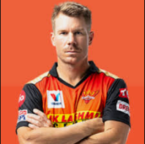
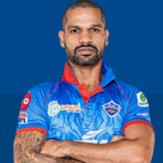
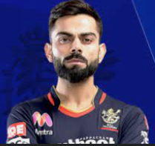
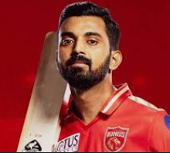

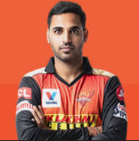




EVALUATE MOST VALUABLE PLAYERS SEASON WISE (BATSMEN & BOWLERS)
There are some key players that each team have from different categories of budget and on which teams performances rely. Top 5 Players from the last 5 seasons has been aggregated and so that we can either retain or pick these players. Some of the top performing batsman and bowlers has been shown below on the basis of highest number of runs and wickets taken.
Below mentioned are the 5 Batsmen and 5 bowlers which are highest runs scorer in last 5 seasons and the leading wicket takers. These players should be the high priority for any franchise to retain or to buy them at once.

Slide 24
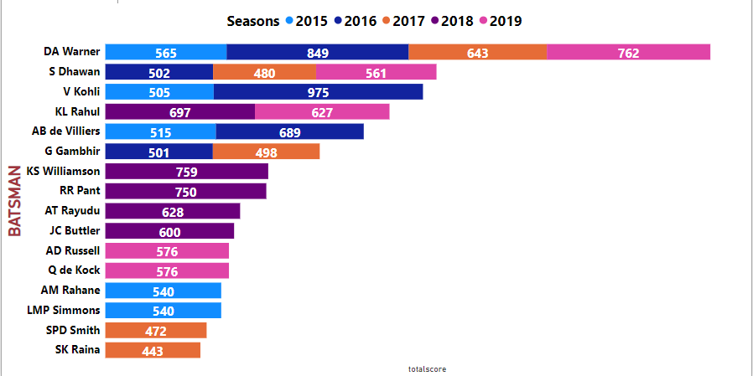
TOP 5 BATSMAN IN EACH SEASON OF IPL 2015-2019

Slide 25
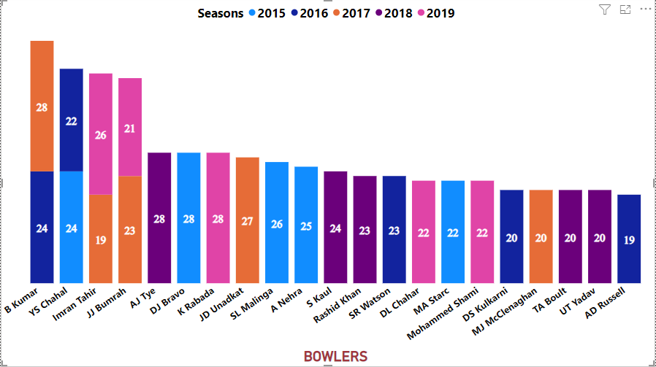
TOP 5 WICKET TAKERS IN EACH SEASON OF IPL 2015-2019

Slide 26
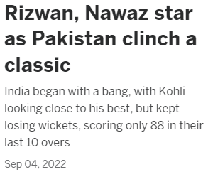
PROPORTION OF WINS BY BATTING FIRST & SECOND AND INCREASING RUNRATE IN DEATH OVERS.
Death overs, can be crucial either by batting first or chasing !!!
The most recent t20 game has witnessed the same stats on September 04,2022

Slide 27
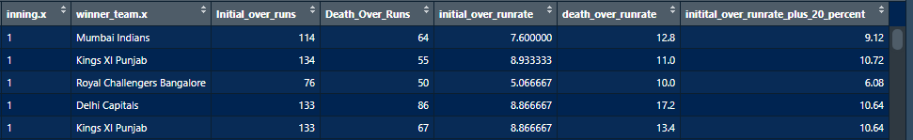
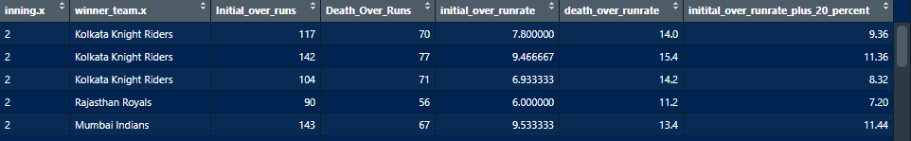
There are total 752 matches out of which 689 went till death overs and the remaining 63 matches finished before death overs.
60 matches finished before death overs while chasing where as 3 matches are those in which team batting first were all out before they reach the death overs.

Slide 28
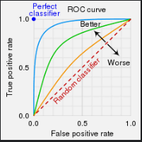
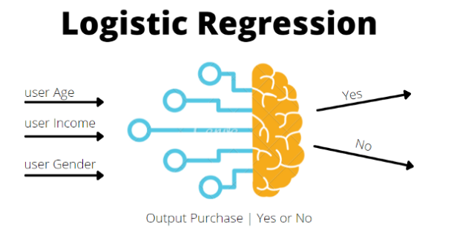
PREDICTICT RESULT OF THE MATCH ON THE BASIS OF FIRST INNINGS SCORE OF THE MATCH.
WIN/LOOSE predictor model on the basis of Logistic regression.
Why Logistic Regression ?
Creating sub data sets for Training and Testing by splitting the original data set in 80/20 Ratio.
Finding Confusion Matrix to determine the Accuracy of the model.
Getting a Receiver Operating Characteristics Curve to get the threshold and Optimizing the model.
Creating logit function in R, to predict loss or win using any independent value

Slide 29
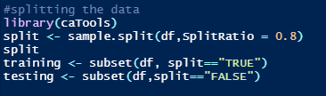
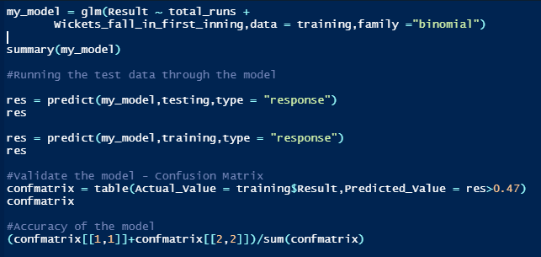
LOGISTIC REGRESSION
Through logistic regression we can find the relationship between Dependent(Win/Loose) variable and Independent variables (Runs made in every first innings of the game & wickets lost by batting first).
Creating sub data sets for Training and Testing by splitting the original data set in 80/20 Ratio.
Finding Confusion Matrix to determine the Accuracy of the model.

Slide 30
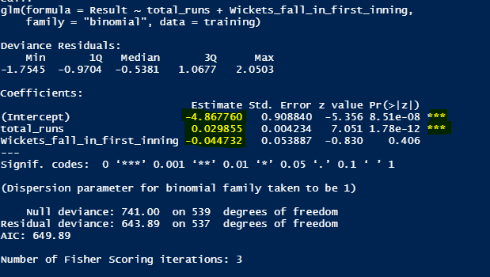
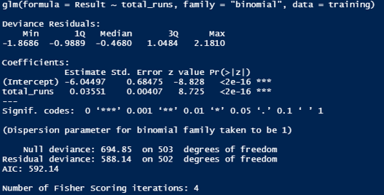
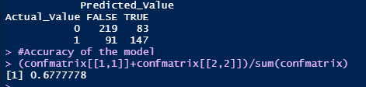
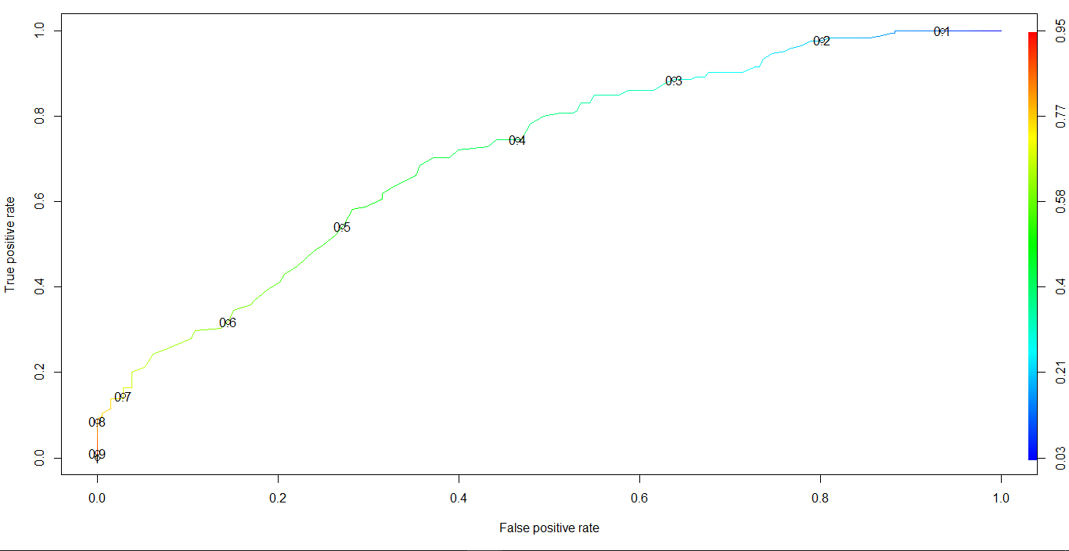
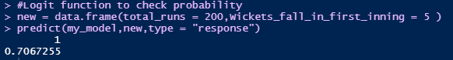
With 2 independent
With 1 independent
ROC curve
If you bat first and score 200 runs in IPL, you have 70.67 % chance of winning, which is 67% reliable.

Slide 31


